Slide 1
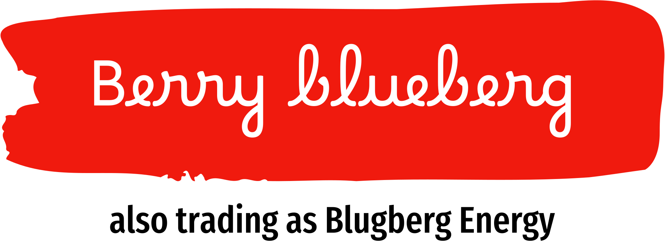
Berry Blueberg SEOP: The Future of Smart Energy Optimization
Inverstor Pitch Deck

Slide 2
Table of contents
02
03
04
01
05
08
Introduction
Problem & solution
SEOP Usecases
What Makes SEOP Unique
06
07
09
Business model &Revenue Strategy
Product
MVP
Timeline & Roadmap
Investment ask & Opportunities
Call to Action

Slide 3
Introduction
01

Slide 4
Our Company
Our Company
Our company
Blue-berg Energy is an innovative startup founded with a mission to accelerate the global transition toward clean, sustainable energy solutions. Established by a group of visionary entrepreneurs passionate about addressing the climate crisis, Blueberg Energy focuses on developing cutting-edge technologies that enable businesses, cities, homeowners and industries to meet their energy needs while significantly reducing their carbon footprint

Slide 5
Our Leadership Team
MATILDA
OTIEDE
SENNO
KAASJAGER
TBD

Slide 6
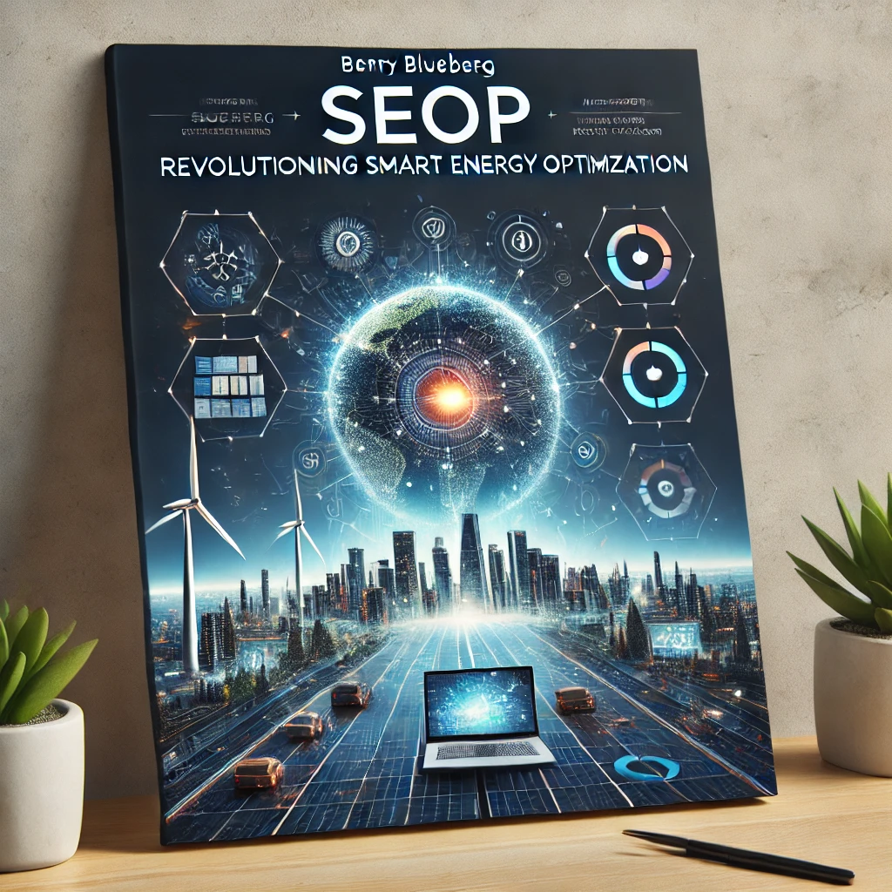
Our Idea
The “our idea” is to lead the global shift to net-zero emissions by empowering businesses, industries, and households to smarter, more sustainable energy solutions. At the core of this vision is the Smart Energy Optimization Platform (SEOP), which drives the transformation to cleaner energy systems through innovative technology and holistic sustainability strategies. strategies.

Slide 7
02
Problem & Solution

Slide 8
Problem
Traditional energy management solutions lack the intelligence, flexibility, and interoperability required to optimise energy systems in a sustainable, cost-effective, and user-centric way. Current approaches focus on static tariff management or single-source energy solutions without considering the complex relationships between devices, energy sources, and user preferences.
The Energy Crisis & Inefficiency
Unpredictable energy costs & waste
Lack of visibility into renewable vs non-renewable consumption
Grid congestion and imbalance in distributed networks
Inefficient coordination between smart meters, grid operators, and local energy systems

Slide 9
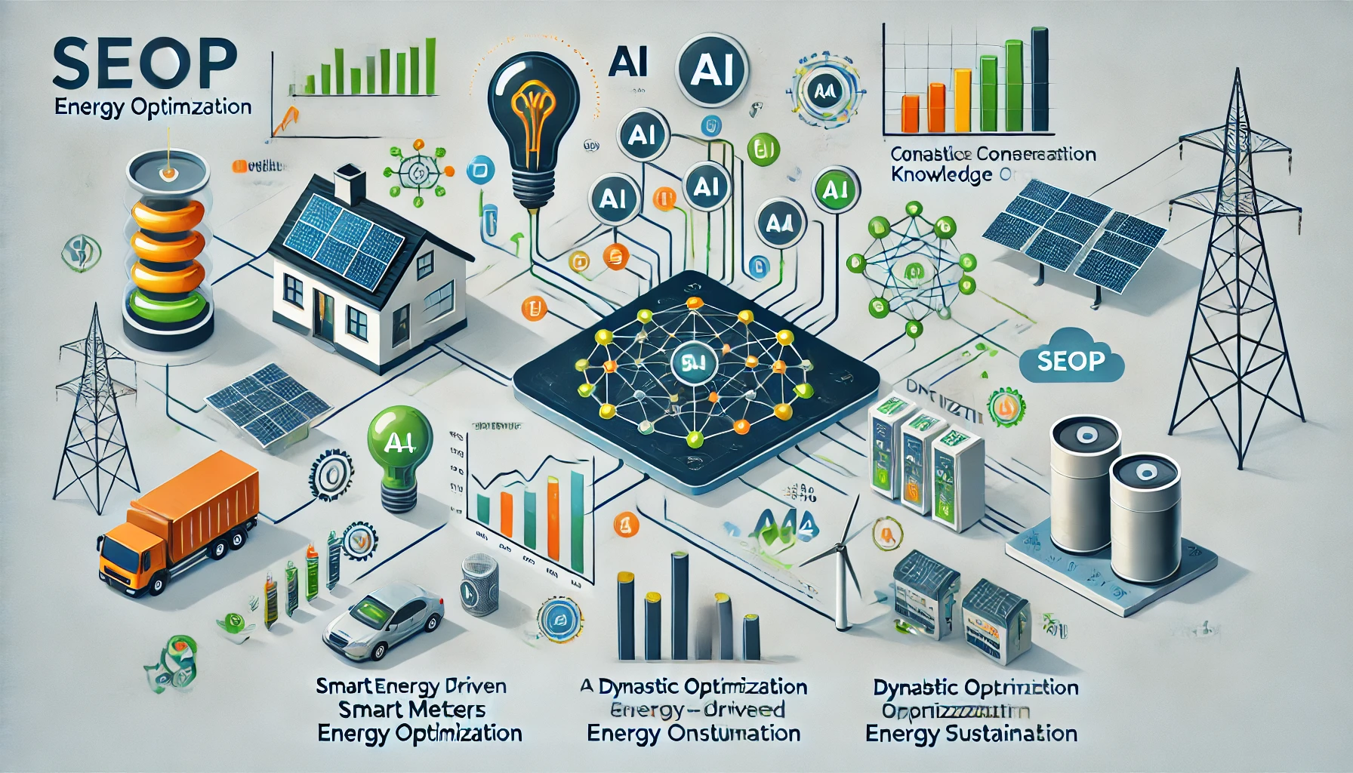
Solution- SEOP’s Smart Energy Optimization
SEOP addresses these challenges by combining A-driven predictive analytics with ontology-based knowledge graphs to create Energy Intelligence Map. This innovation empowers users to:
Dynamically optimise energy consumption across multiple sources
( solar, grid, batteries).
Ensure seamless interoperability of devices within their energy ecosystems.
Ontology-driven energy device mapping (Smart meters etc)
Real-time monitoring of renewable vs non-renewable usage
Receive personalised , actionable insights for reducing energy cost and carbon footprints.

Slide 10
03
What Makes SEOP Unique

Slide 11
Value Preposition
Beyond Tariff-Based Systems
Ontology-Driven Intelligence
Focused Use Cases
While competitors focus on optimizing tariffs, SEOP identifies broader correlations:
Example: Predicting and managing system-level inefficiencies (e.g., heat pump oversupply) based on energy production/consumption patterns.
SEOP's knowledge graph learns and evolves:
Adds new devices (e.g., wind turbines or electric vehicles) without extensive reconfiguration.
Generates context-rich energy insights (e.g., grid constraints + device efficiency).
Instead of being a generic platform, SEOP focuses initially on homeowners who:
Already own or are planning to own multiple energy devices.
Want actionable guidance, not just data aggregation

Slide 12
Key Differentiation: SEOP vs. 1KOMMA5°
Use Case Example
Knowledge Graphs as Contextual Intelligence
SEOP uses knowledge graphs to map relationships and contextual data at a highly granular level. This includes:
Weather patterns tied to localized microclimates.
Device health data (e.g., aging battery performance).
Socioeconomic data (e.g., local tariff structures, household income trends).
This context-awareness goes beyond simple energy production/consumption matching offered by 1KOMMA5°.
1KOMMA5° might optimize based on a drop in solar output by increasing grid energy usage when prices are low.
SEOP can simulate:
Using stored energy intelligently across appliances.
Prioritizing essential devices (e.g., heat pumps during extreme weather).
Suggesting user-specific actions like pre-charging batteries before price hikes.

Slide 13
Key Differentiation: SEOP vs. 1KOMMA5°
Summary of Differentiation
Feature | 1KOMMA5° | SEOP (Differentiated)
Dynamic Optimization | Based on current inputs. | Proactive with simulations + context-aware optimization.
Granularity | Focused on devices and sources. | Includes socio-economic, regulatory, and environmental data.
Interoperability | Limited to integrated systems. | Open, ontology-driven, multi-vendor.
User Customization | Limited. | Rich, flexible, and user-prioritized.

Slide 14
04
SEOP USECases

Slide 15
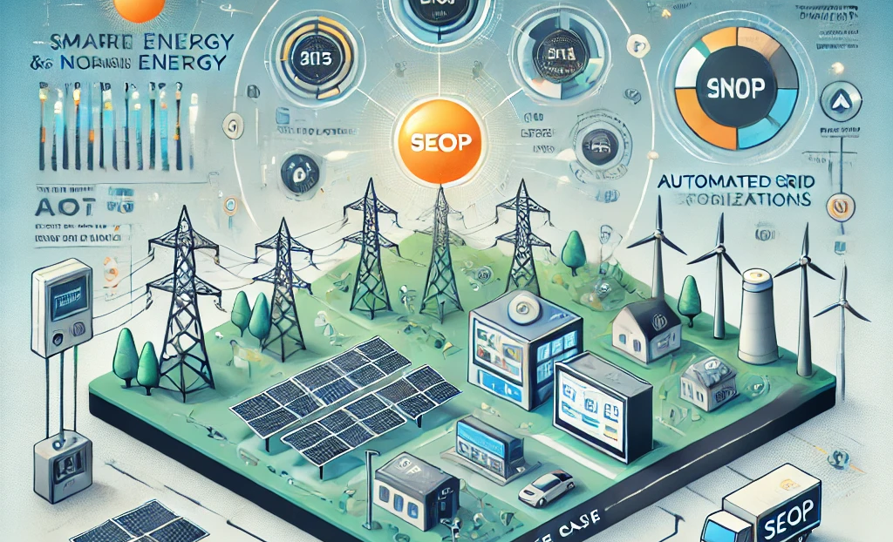
DNOs Use-Case
Use Case Example:
Scenario: A DNO needs to track and optimise the share of solar & wind in its local grid.
SEOP integrates with smart meters & grid sensors to collect energy flow data.
Ontology-driven models distinguish between solar self-consumption, grid imports, and exports.
AI-powered forecasting predicts upcoming renewable energy variations.
Grid operators receive real-time insights via the SEOP

Slide 16
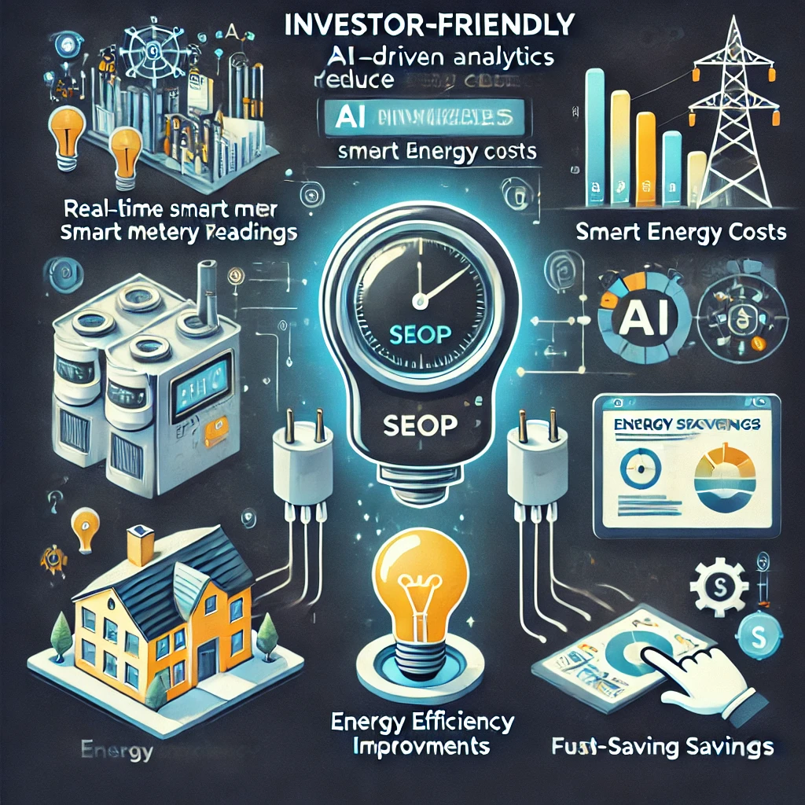
Smart Meter Use-Case
Use Case Example:
SMART METER
SEOP transforms smart meters from passive monitors into intelligent energy optimization tools.
Advanced Energy Intelligence Mapping
SEOP integrates with smart meters and builds a Knowledge Graph of all connected energy devices (solar panels, EV chargers, heat pumps, etc.).
It maps energy flows and identifies inefficiencies in real time.
AI-Driven Dynamic Optimization
SEOP predicts energy demand and automatically shifts loads to the cheapest or most sustainable energy source.
Example: If grid electricity is expensive, it switches to battery storage or solar.

Slide 17
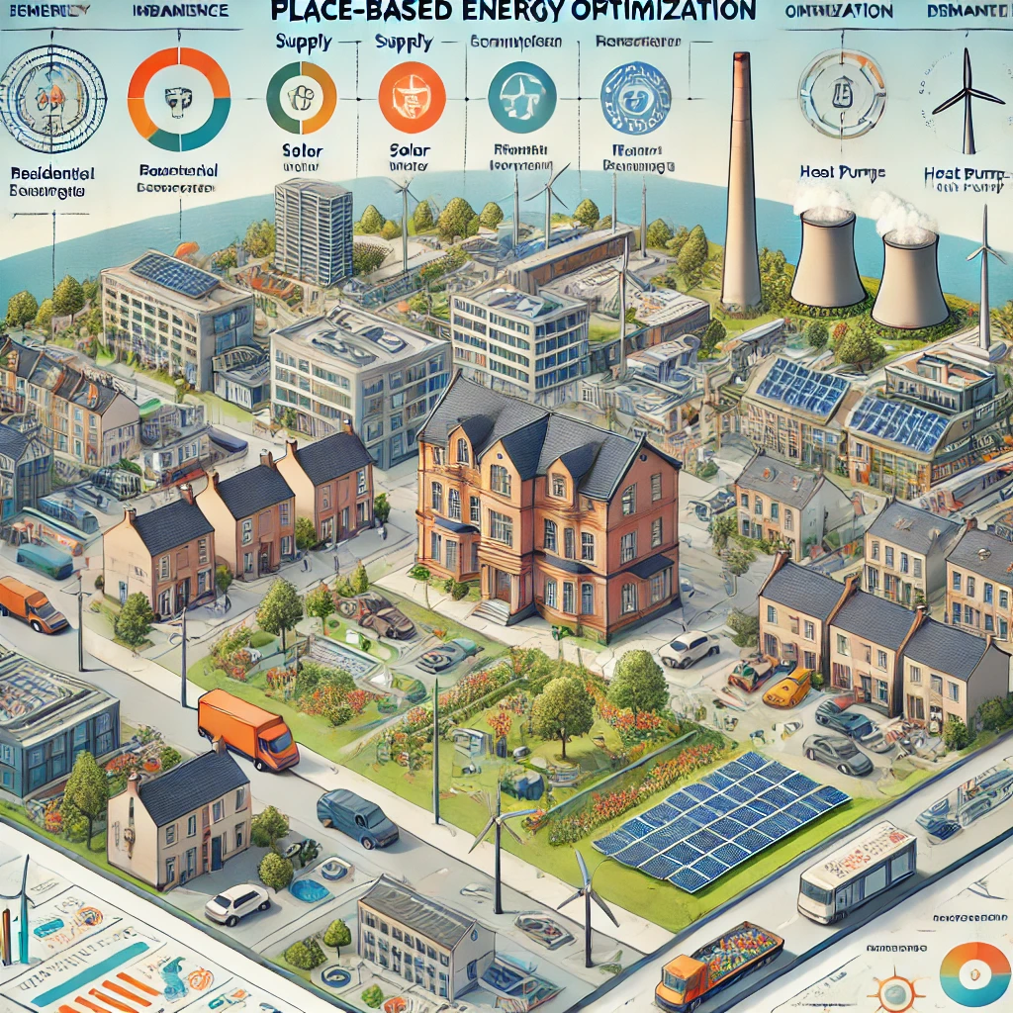
Placed Based Use-Case
Use Case Example:
Inaccurate Tracking of Renewable Energy Contribution
The city wants to track the proportion of total energy demand met by local renewables (solar, wind, heat pumps).
However, data is siloed across different agencies, energy providers, and smart meters.
There is no unified system to dynamically aggregate, monitor, and visualize real-time renewable energy generation vs. total energy consumption
How SEOP Can Help Solve These Problems
Real-Time Energy Intelligence Mapping (Using Knowledge Graphs)
SEOP creates an interoperable layer connecting smart meters, renewable energy assets, and demand-side data.
Maps the real-time flow of renewable vs. grid energy across the district.

Slide 18
05
Business Model and Revenue Strategy

Slide 19
Market size overview
Outer circle
£100M
Renewable energy projects, broader consumer base, smart cities (massive long-term potential,
£20M
Middle circle
Utilities, government agencies, corporate sustainability programs (~50,000+ corporates globally
Inner circle
£5M
Smart homes, device manufacturers, SMEs (~300 million+ users by 2025).

Slide 20
Revenue Streams
SEOP can generate revenue through a combination of subscription models, licensing, and energy market integration
Core Revenue Streams
Revenue Model | Description | Target Customers | Pricing Model
1. Subscription-Based Energy Optimization (B2B/B2C) | AI-powered optimization for residential, commercial, and industrial users. | Households, Businesses, Energy Providers, Smart Meter Operators | Monthly/Annual Subscription (£10–£50 per user)
2. Data Monetization & Energy Analytics | Selling energy consumption insights to utilities & smart meter companies. | Smart Meter Providers, Grid Operators, Energy Research Firms | Pay-per-use data access or licensing model
3. Licensing AI-Powered Smart Grid Solutions | Licensing AI-based energy management to smart meter companies, utilities, and businesses. | Utilities, Smart Meter Companies, Energy Service Providers | Per-device license fee or annual SaaS model (£100K+/yr for utilities)
4. Peer-to-Peer (P2P) Energy Trading Fees | Enabling local energy communities to trade excess solar/wind power. | Households, Businesses, Community Energy Groups | 1-2% transaction fee
5. Hardware Integration Fees (IoT Devices & Smart Meters) | Partnerships with hardware manufacturers to integrate SEOP. | Smart Meter Providers, Home Automation Companies | Per-device integration fee (£5–£20 per unit)
£

Slide 21
Cost Structure
Cost Categories
Cost Category | Details | Estimated Cost %
Ontology, AI & Software Development | Building and maintaining the Ontology and AI-powered energy optimization platform. | 40%
Cloud & Data Storage | Hosting, processing real-time energy data from devices & smart meters. | 15%
Customer Acquisition & Sales | Marketing, partnerships, business development. | 20%
Regulatory & Compliance | Certification for grid integration, data privacy regulations. | 10%
Operations & Admin | Team salaries, office expenses, legal costs. | 15%

Slide 22
FINANCIAL PROJECTIONS
REQUIRED FUNDING
Year 1: 2,000,000
Year 2: 2,000,000
Year 3: 1,000,000
Total: 5,000,000
ROI
Year 1: 20%
Year 2: 50%
Year 3: 150%
16

Slide 23
FINANCIAL PROJECTIONS
3-Year Financial Projections Table
Year | Revenue (£) | Expenses (£) | Net Profit (£) | ROI | Key Milestone
Year 1 | 500,000 | 2,000,000 | -1,500,000 | -75% | MVP Development
Year 2 | 1,500,000 | 2,000,000 | -500,000 | -25% | Pilot Projects
Year 3 | 4,000,000 | 1,600,000 | 2,400,000 | 150% | Commercial Launch
Key Milestones:
Year 1: Launch MVP, establish pilot partnerships, secure early adopters.
Year 2: Expand pilot programs, refine product offerings, strengthen partnerships.
Year 3: Commercial launch, scale operations, achieve profitability.
Assumptions Behind Projections:
Assumption | Details
Initial User Base | 50 clients in Year 1
Annual Growth Rate | 50% growth per year
Average Subscription Price | £20,000 per year
Carbon Offset Transactions | £1 million by Year 3
Sensitivity Analysis
Scenario | Revenue (£) | Expenses (£) | Net Profit (£)
Best Case | 5,000,000 | 1,400,000 | 3,600,000
Average Case | 4,000,000 | 1,600,000 | 2,400,000
Worst Case | 2,500,000 | 1,800,000 | 700,000

Slide 24
Investor Value Preposition
Market Demand: The global smart energy market is projected to grow to £6.8 by 2030.
Scalability: SEOP’s AI-driven platform can expand across multiple regions and industries.
Competitive Edge: Unlike competitors, SEOP leverages knowledge graphs & AI-powered optimization.
Exit Potential: Potential acquisition by utilities, smart meter companies, or tech giants

Slide 25
04
Product MVP

Slide 26
SEOP MVP Core Areas
Knowledge Graph as Energy Intelligence Maps
Ontology-Driven Device Interoperability
Purpose: To map and correlate diverse energy variables (e.g., weather patterns, energy demand spikes, equipment efficiency, local grid constraints) into a unified, intelligent framework.
Benefit: Enables dynamic optimisation, scenario forecasting, and personalised energy strategies that go beyond static tariff-based models.
Use Case: Provide actionable insights on energy usage, optimise renewable and grid energy consumption, and improve overall system efficiency.
Purpose: To ensure seamless integration and communication between energy devices (e.g., solar panels, heat pumps, EV chargers, batteries) using a standardised ontology.
Benefit: Eliminates silos between devices, allowing them to work together efficiently and adapt dynamically to changing conditions.
Use Case: Automating energy decisions, such as optimising energy storage usage or switching between energy sources to balance cost and sustainability.

Slide 27
SEOP MVP Features
Knowledge Graph Framework
Actionable Insights:
Translate knowledge graph insights into single-scenario recommendations: Charge the battery now to prepare for high grid prices tomorrow. Shift heat pump usage to midday for better solar efficiency."
.
Build a simplified ontology for energy devices: Nodes: Devices (e.g., solar panels, batteries, heat pumps) and external factors (e.g., weather, tariffs, grid conditions).
Edges: Relationships like energy flow, cost, and efficiency metrics. Use this graph to identify correlations and dependencies.
Interoperability Prototype:
Connect 2-3 device types (e.g., solar panel + battery + heat pump).Enable these devices to "communicate" through the knowledge graph for synchronized actions.
.
Why MVP
The MVP focuses on building a foundational system to validate the core idea—ontology-driven interoperability and actionable insights. Early feedback will help refine features and demonstrate feasibility to users and investors.
.
User Interaction:
Basic dashboard visualizing: Device performance and energy flow. Single recommendation based on the knowledge graph insights.
.
.

Slide 28
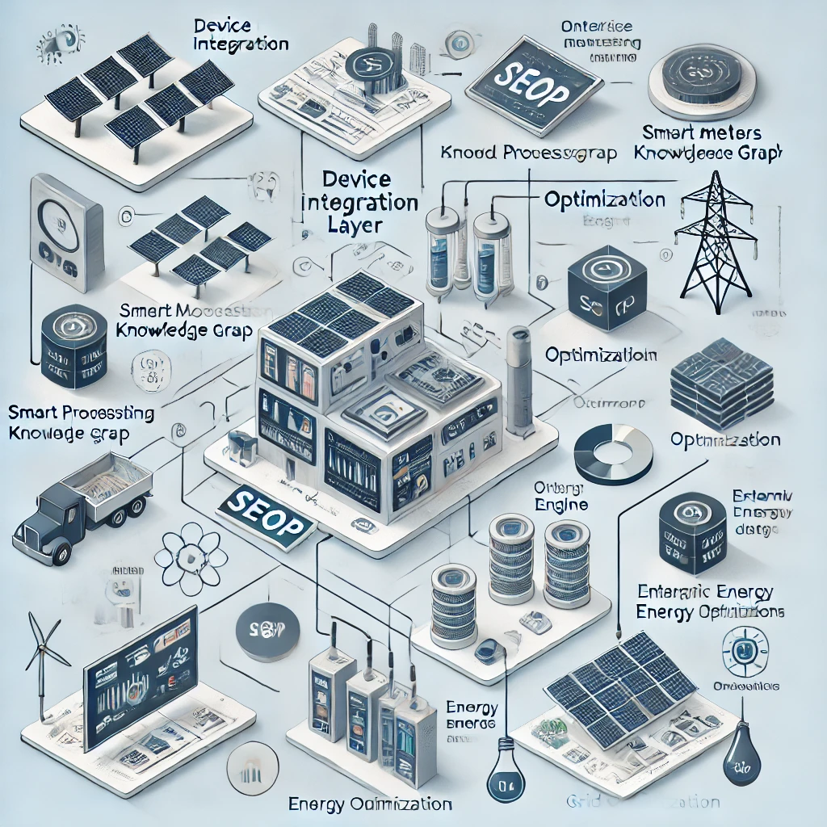
SEOP Development Layers
Phase 1 SEOP Development
Smart
Energy Optimization Platform
(SEOP)
Data Layer
Data
Device Integration Layer
Ontology & Sematic Layer
Scaling Up-
Further Development
Control & User Interface Layer
Intelligence & Analytics Layer
Ecosystem and Scalability Layer

Slide 29
07
Timeline and Roadmap

Slide 30
Timeline
Phase2
Phase1
Launch a basic dashboard for actionable recommendations and energy flow visualization.
Introduce multi-scenario simulations for comprehensive energy optimisation.
2026
2028
2025
Further Development
Build and test the Knowledge Graph Framework for device relationships and dependencies
Enhance AI-driven analytics for predictive maintenance and long-term planning.
.
Develop the Interoperability Prototype with 2-3 energy devices.
.
Expand device integration to cover EV chargers, smart appliances, and more.
2027
24

Slide 31
Phase 1 Development Roadmap
1
2
3
4
Research and device manufactures engagement
Define Ontology and Data standards
Prototype Solid integration
Semantic Layer Development
5
6
7
8
User Data Pods
Beta Device Compatibility
Dynamic data sharing via Pods
9
User Interface Development

Slide 32
Team Composition
.
CEO
Experienced in energy systems and sustainability strategies.
Knowledge Graph Specialist
Energy Systems Engineer
Software Developer
Expert in ontology design and semantic technologies.
Skilled in renewable energy device integration and optimization.
Focused on building robust and scalable platforms
Team Expertise
Ontology-based knowledge graphs for data modeling
Scalable, cloud-based architecture for future integrations.
AI-driven analytics for real-time decision-making.

Slide 33
08
Investment ask and Opportunities

Slide 34
Investment Ask and Opportunities
📌 Why Invest in SEOP? 📈 Growing demand for smart energy solutions 📈 Competitive differentiation with AI & Knowledge Graphs 📈 Scalable, high-revenue potential business model 💰 Funding Required: £5 Million for Product Development & Market Penetration.
Funding Category
Category | Amount (£) | % of Total Funding
Technology & R&D | 1,500,000 | 30%
Product Development | 1,000,000 | 20%
Marketing & Sales | 1,000,000 | 20%
Talent Acquisition | 750,000 | 15%
Regulatory Compliance | 750,000 | 15%

Slide 35
06
Closing and Call to action

Slide 36
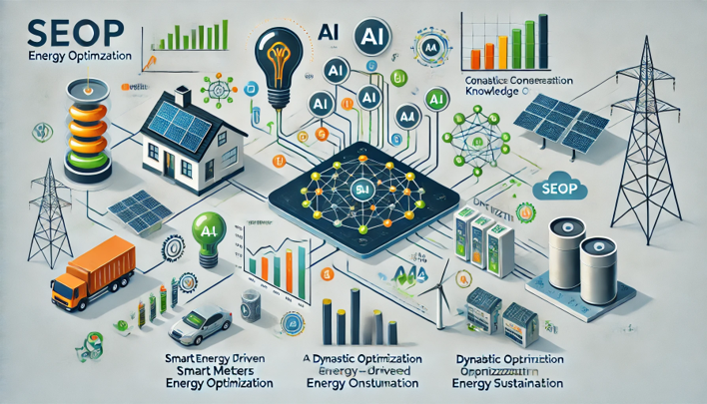
Closing and Call to action
📌 Join Us in Transforming Energy Optimization! 🔗 energy@blue-berg.com
📅 Schedule a Demo / Meeting

Slide 37
Thanks!

